Slide 1
Javascript vs. Java

Slide 2
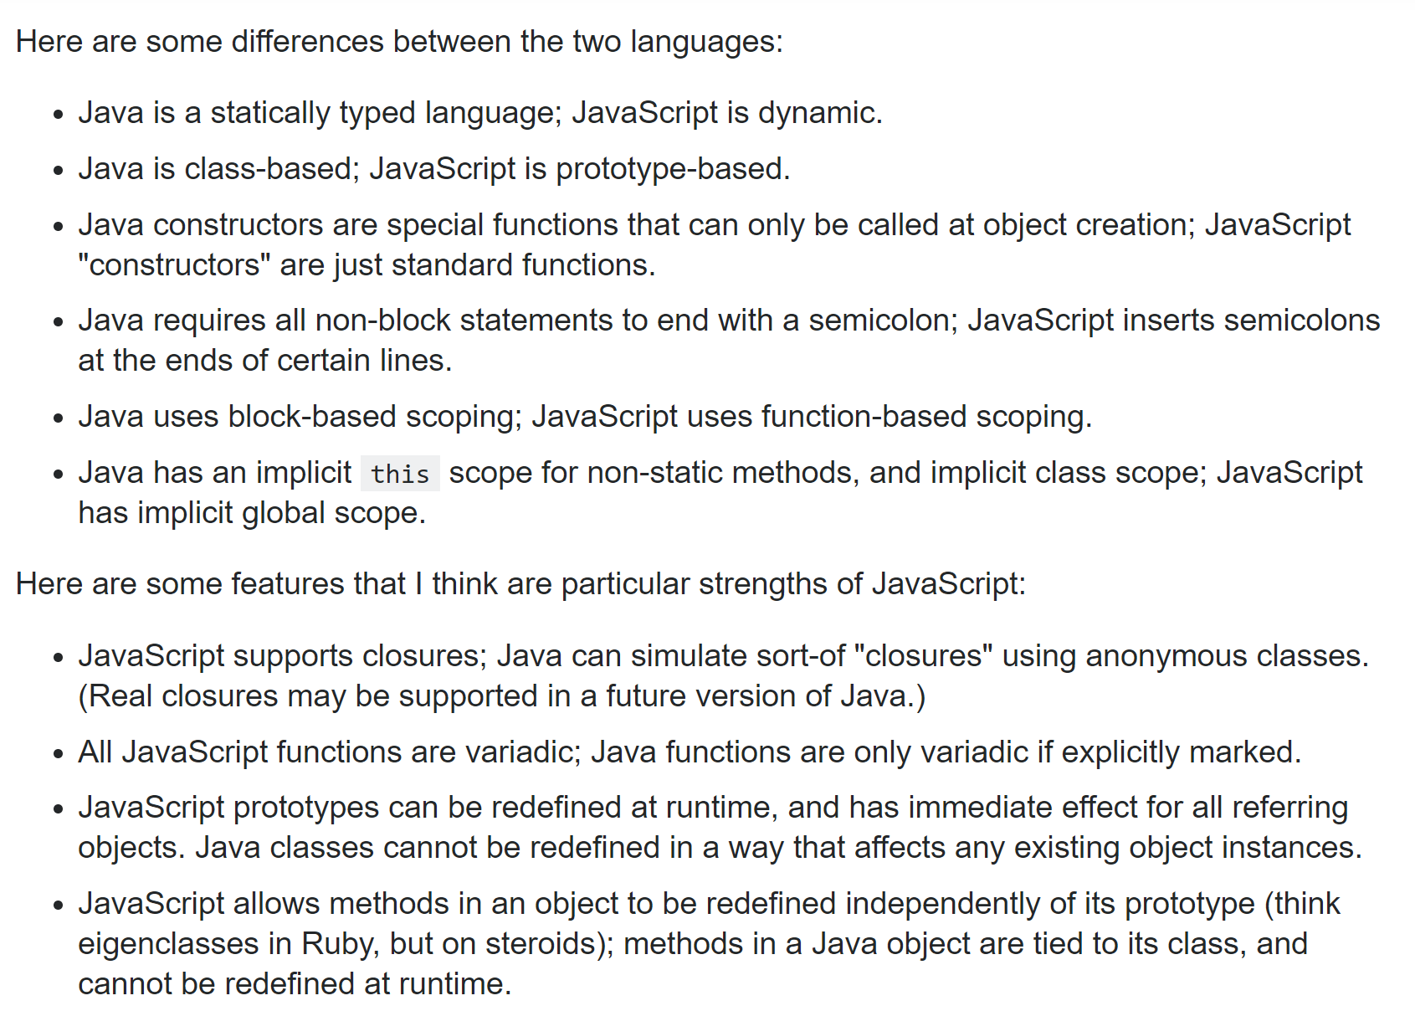
This is a thoughtful post…
https://stackoverflow.com/questions/245062/whats-the-difference-between-javascript-and-java
I would add: Java supports multi-threaded access to mutable data structures shared in memory;
In javascript, everything is multi-threaded except your code which runs single-threaded.
In Java GUIs, blocking code can be run in a background thread with callbacks to the GUI (AWT thread);
In browswer-based javascript, there is only the GUI thread and blocking functions are usually run on the server
(with a callback function to the single-threaded javascript code)

Slide 3
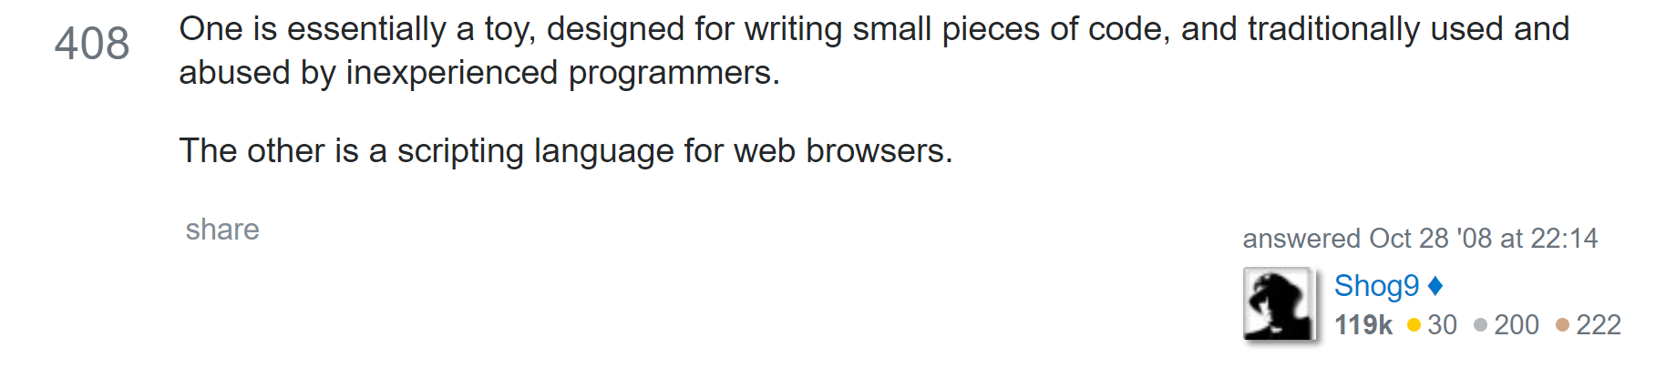
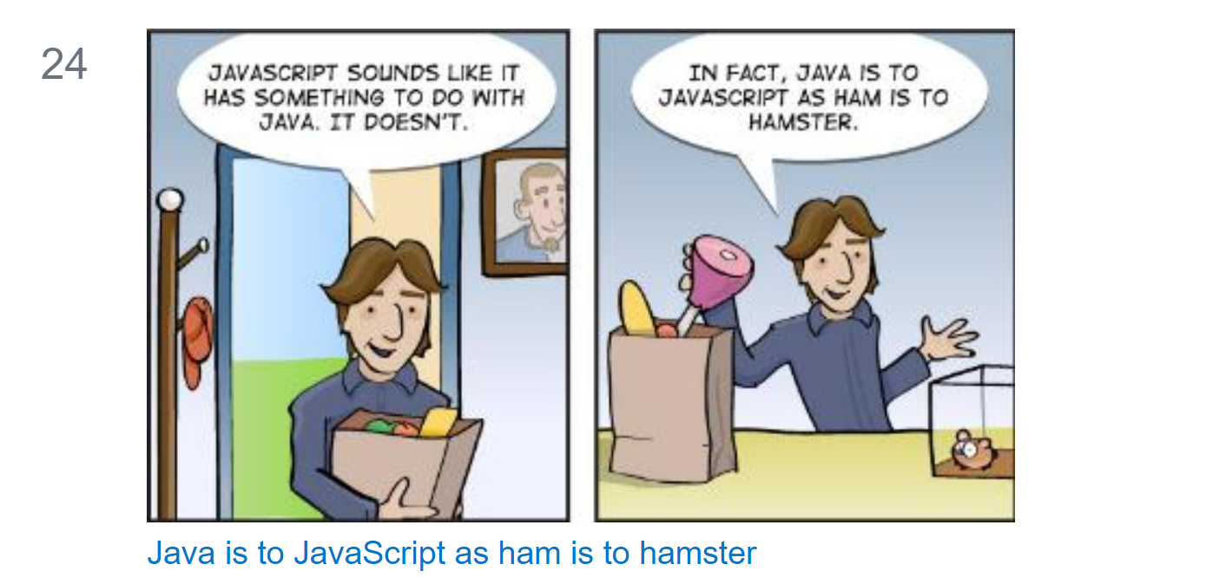
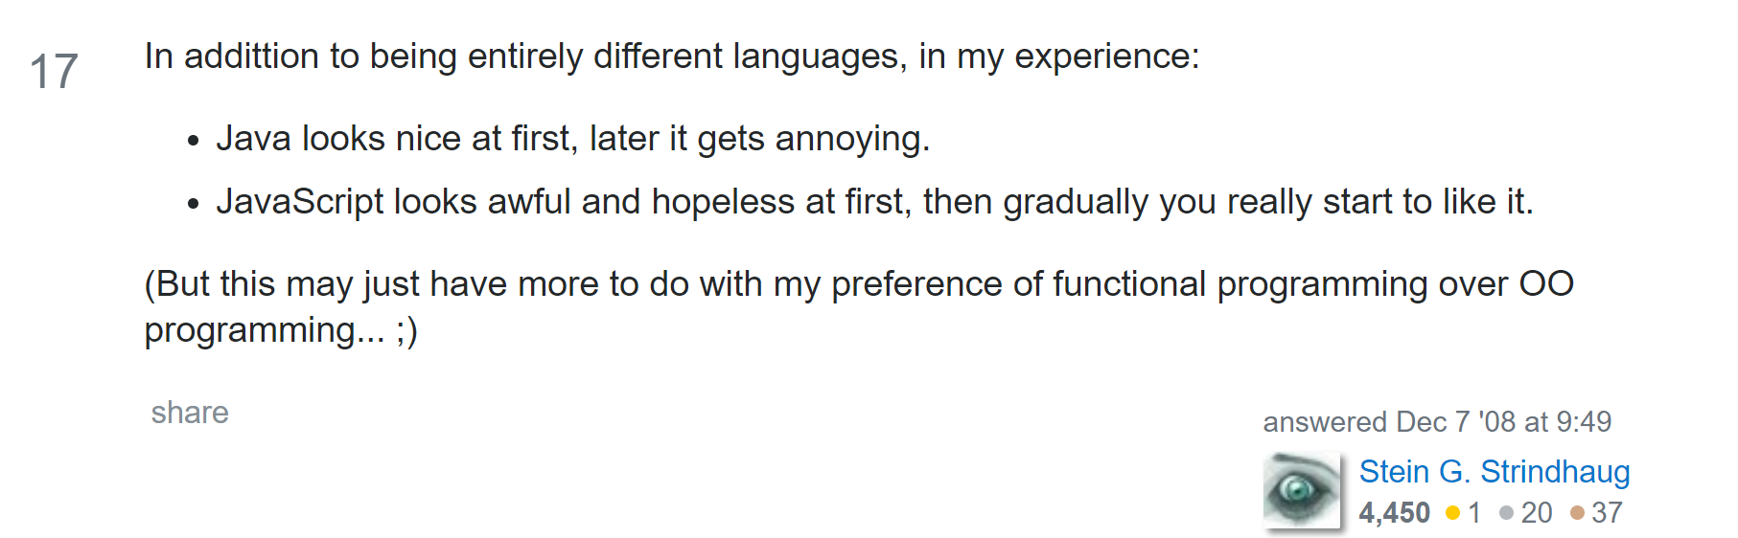
https://stackoverflow.com/questions/245062/whats-the-difference-between-javascript-and-java
There are also jokes, digs and things to think about…

Slide 4
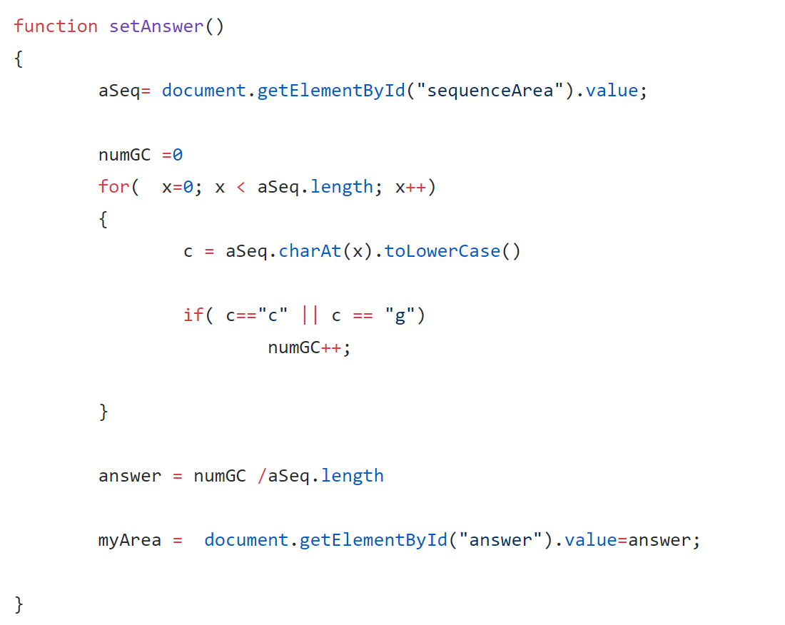
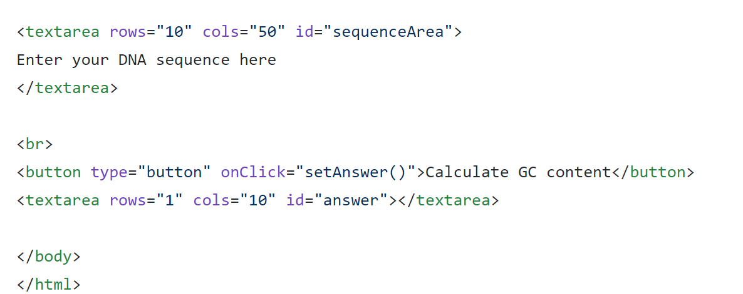
We’ve already seen javascript in the browser..
https://github.com/afodor/afodor.github.io/blob/master/exampleInput.html

Slide 5
Callbacks into the javascript thread work very similarly to callbacks to the AWT thread in Java
Javascript thread
User
Clicks on button
javascript does a bunch of things
Callback function() gets called when
javascript gets around to it
javascript does a bunch of other things
If you do something slow on the javascript thread you will crash the browser.
(Which is an unfriendly thing to your user)

Slide 6
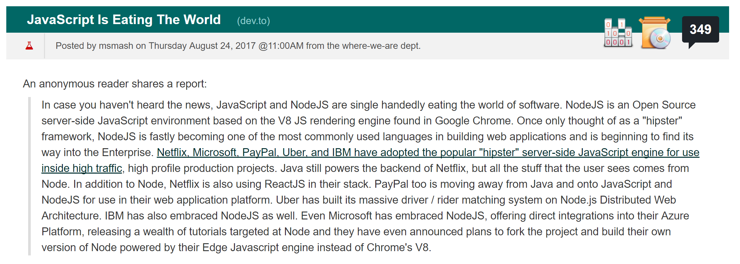
Surprisingly, javascript is gaining traction on the server using node.js.
node.js allows us to run javascript from the command line, which is useful when learning the language…
https://developers.slashdot.org/story/17/08/24/1457245/javascript-is-eating-the-world

Slide 7
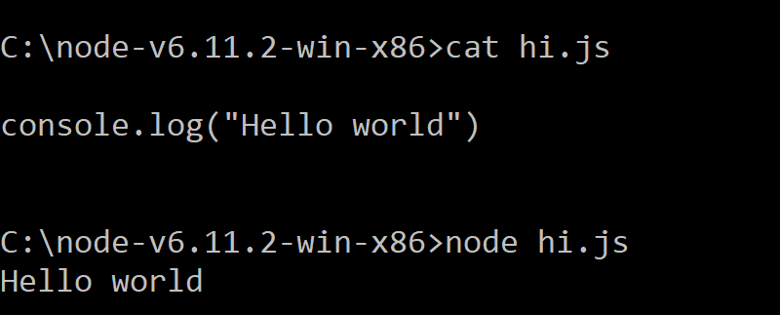
After installing node.js (on the platform of your choice) you will have a “node” executable…

Slide 8
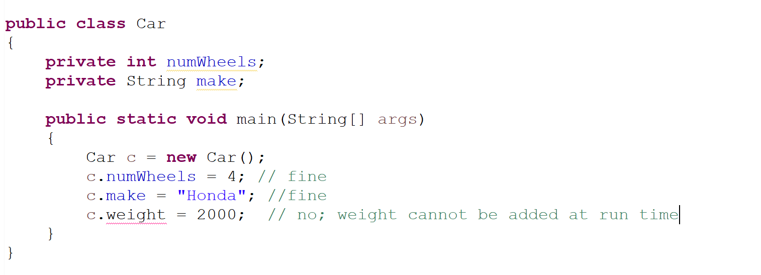
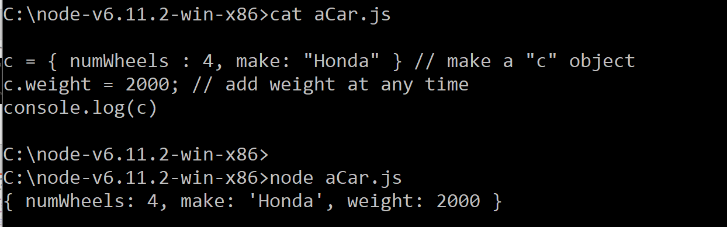
Java is a statically typed language; JavaScript is dynamic.
In Java, classes are defined at run time; you can’t add
features at run time
In javascript, there are no classes.
Everything is an object.
You can always add features to your object.
Objects in javascript are sort of like hash maps or
dictionaries ;
Just a collection of keys and values…
Objects in Java are instances of strongly-typed classes
(whose contents are defined at compile time but
instantiated at run-time)

Slide 9
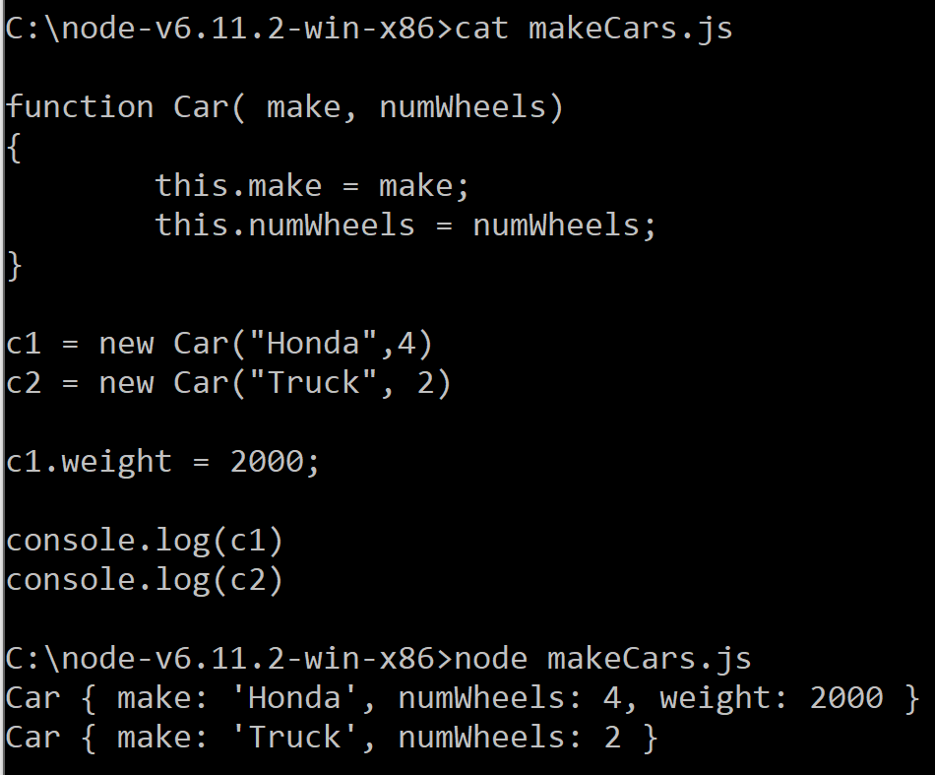
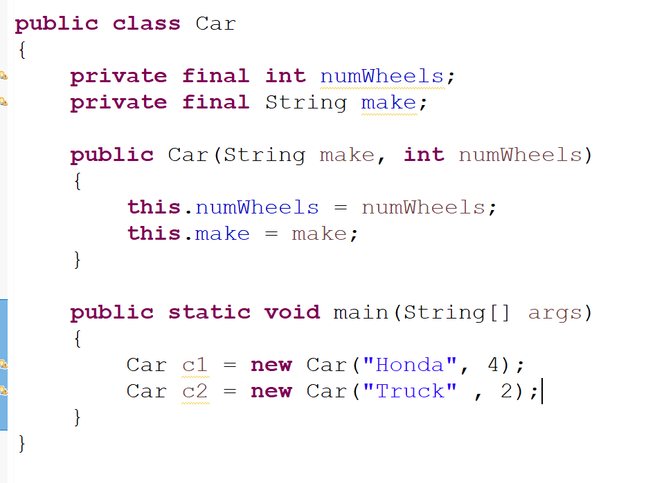
Java constructors are special functions that can only be called at object creation; JavaScript "constructors" are just standard functions.

Slide 10
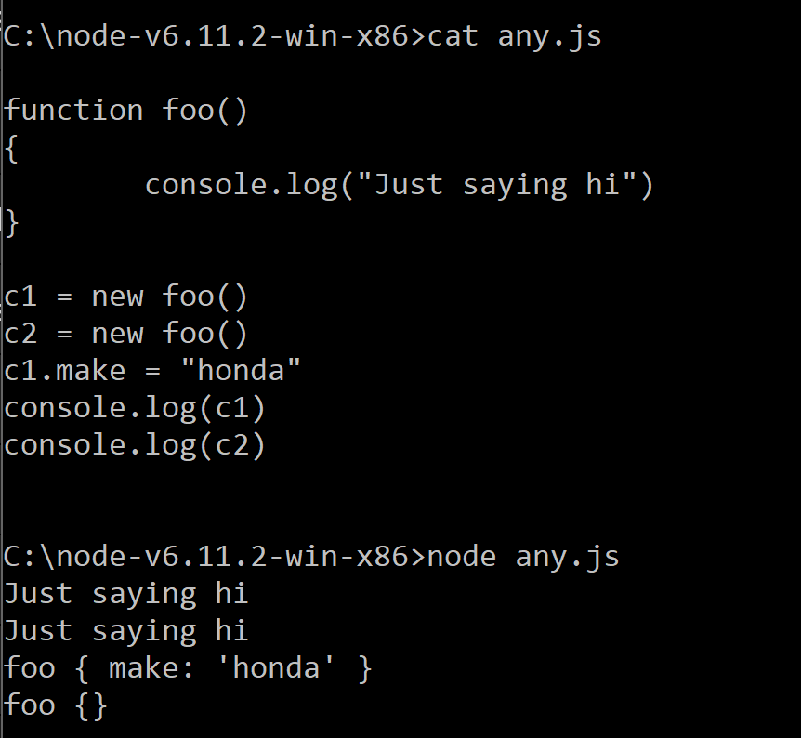
In Javascript, any function can be a constructor (but by style convention, they start with capitol letters)

Slide 11
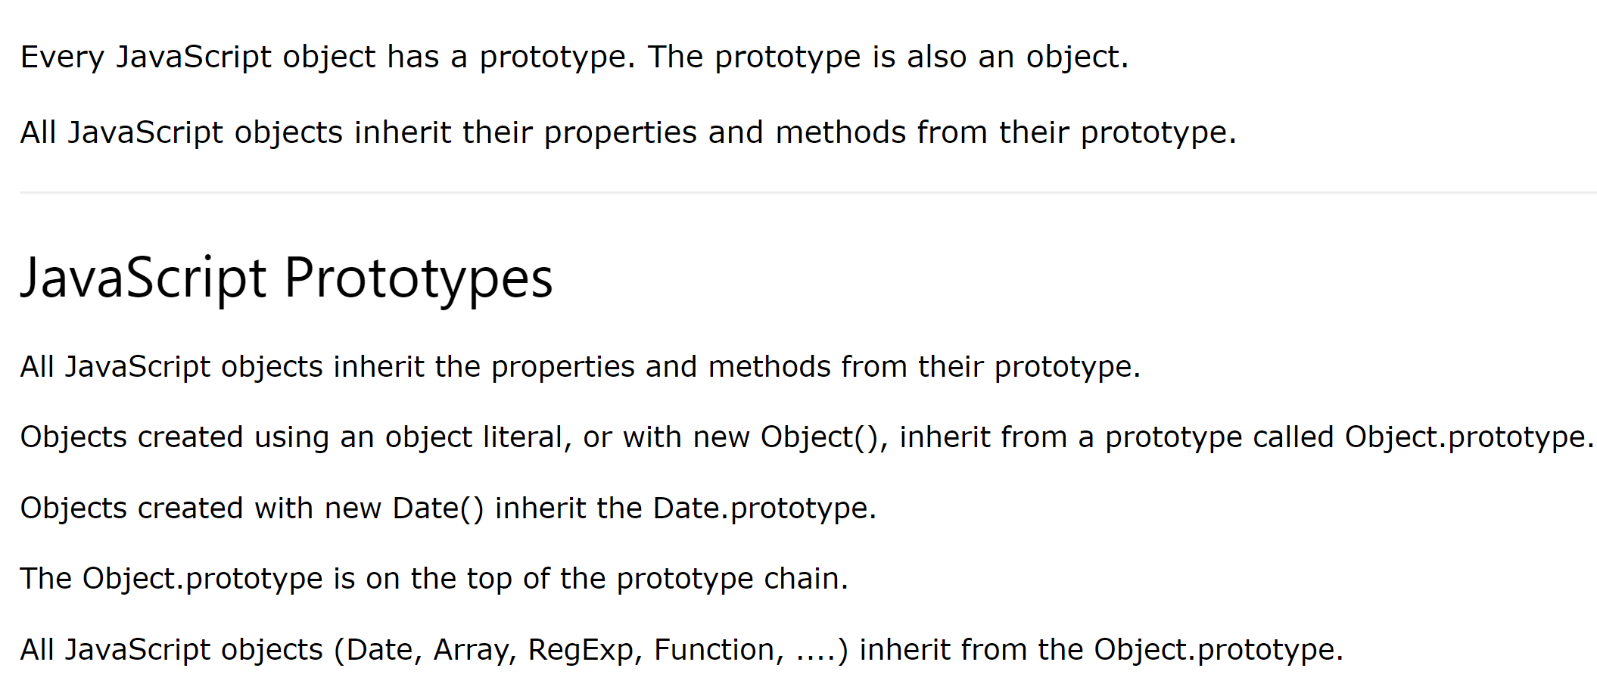
Java is class-based; JavaScript is prototype-based.
https://www.w3schools.com/js/js_object_prototypes.asp
All classes inherit from Object in Java
Run-time changes to the prototype change all the derived
objects
Super classes (like all other classes in
Java) can’t be changed at run-time
https://www.w3schools.com/js/js_object_prototypes.asp

Slide 12
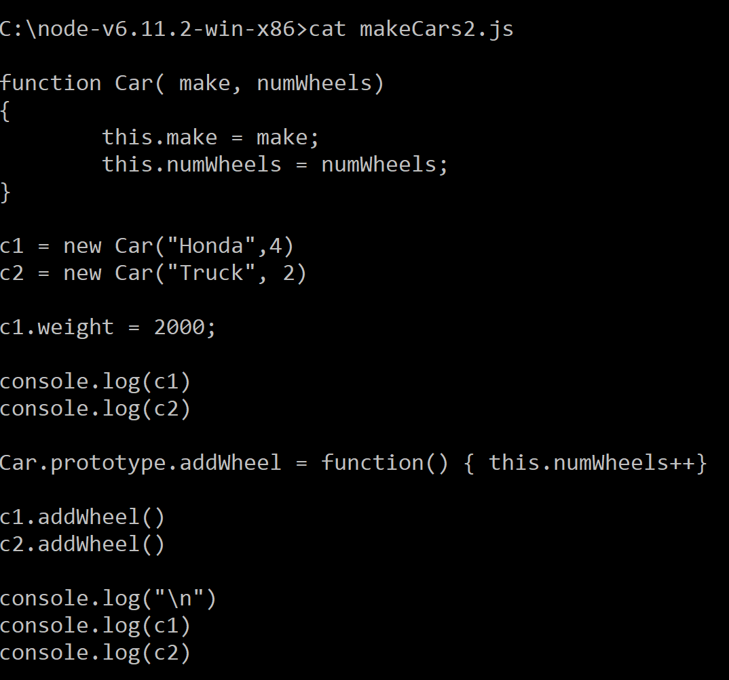
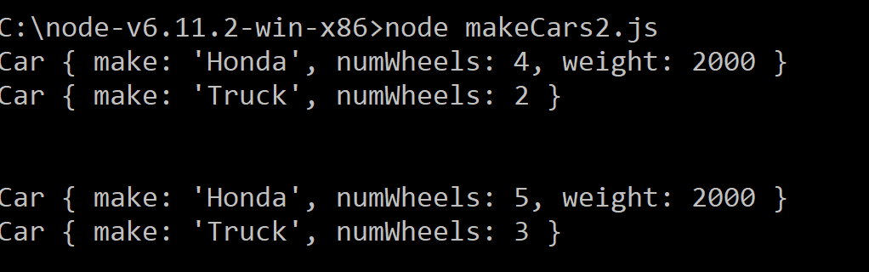
Run-time changes to the prototype change all the derived objects
There is no equivalent to this in Java….

Slide 13
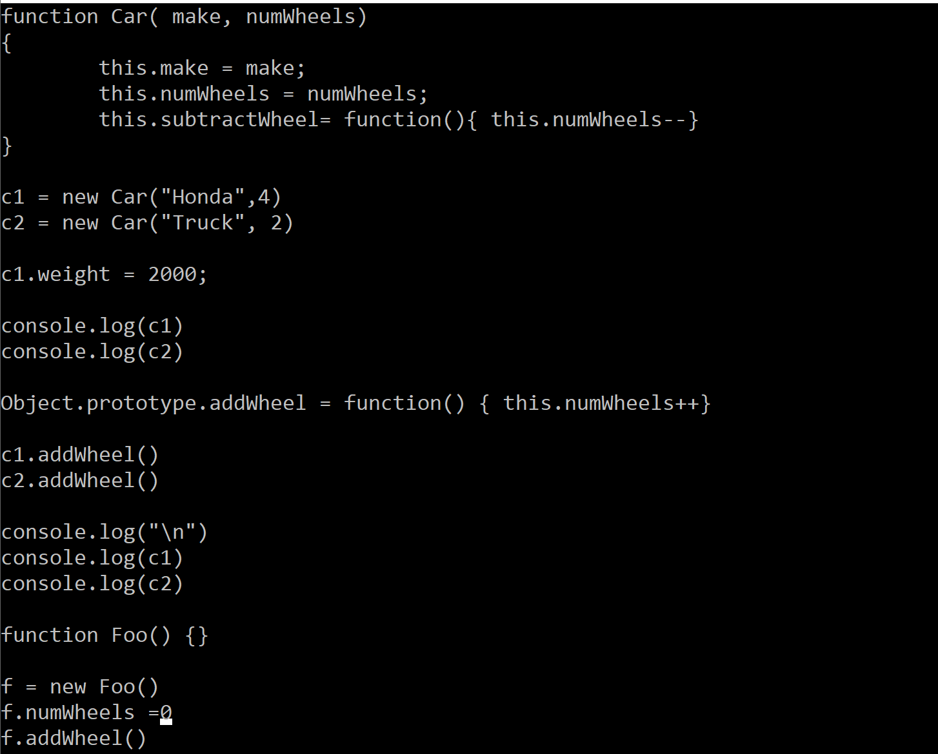
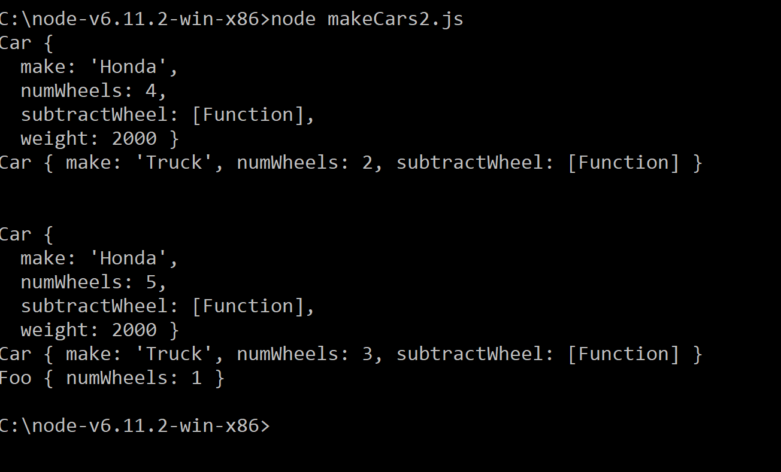
Changing the Object prototype, changes the behavior of all objects that have been and will be created in your javascript session
There is, to put it mildly, no equivalent in Java.
This maximizes flexibility but removes all
possibility of strong typing, which goes
against the Java design principle…

Slide 14
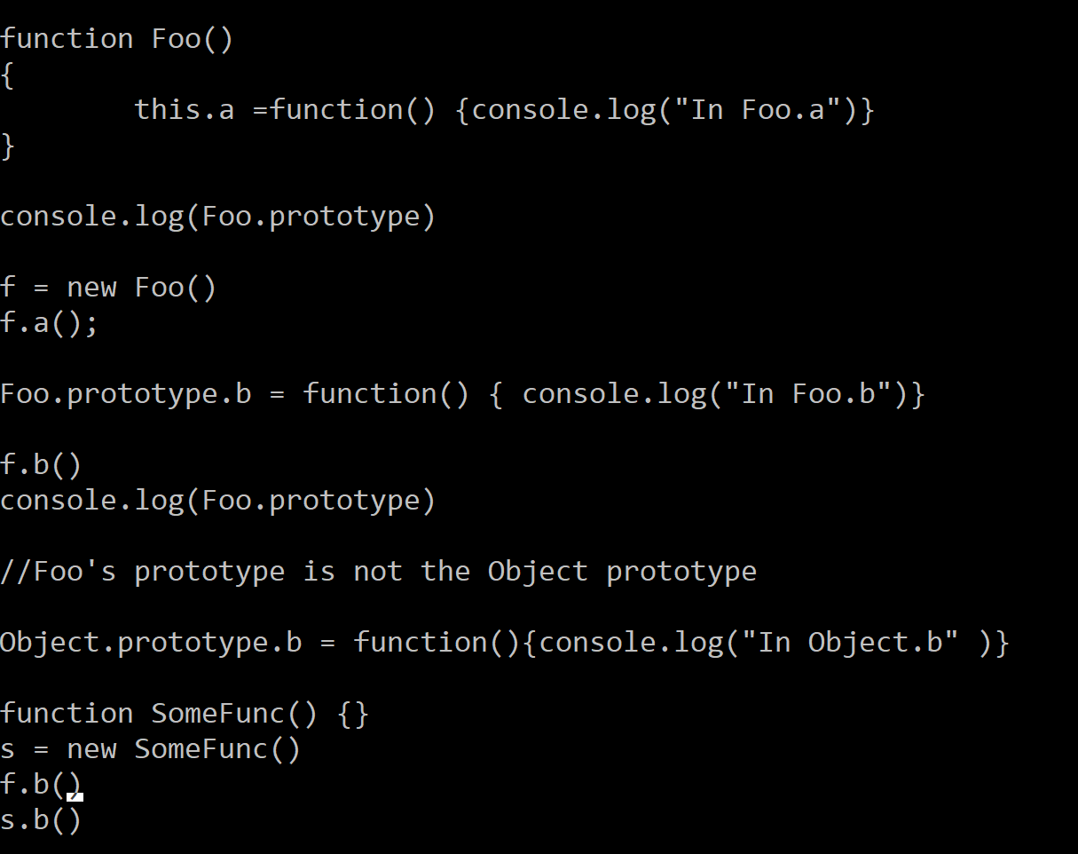
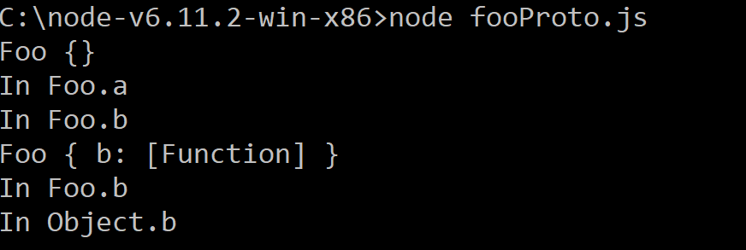
In Java, all classes extend Object. If you don’t specify a parent class, you directly inherit from Object
In Javascript, when you use “new”, you get a prototype associated with that object.
The prototype of your new prototype is the Object prototype (which is the top of the prototype chain)
Object.prototype
Foo.prototype
Object
Foo
Foo
Javascript new Foo()
Java new Foo()

Slide 15
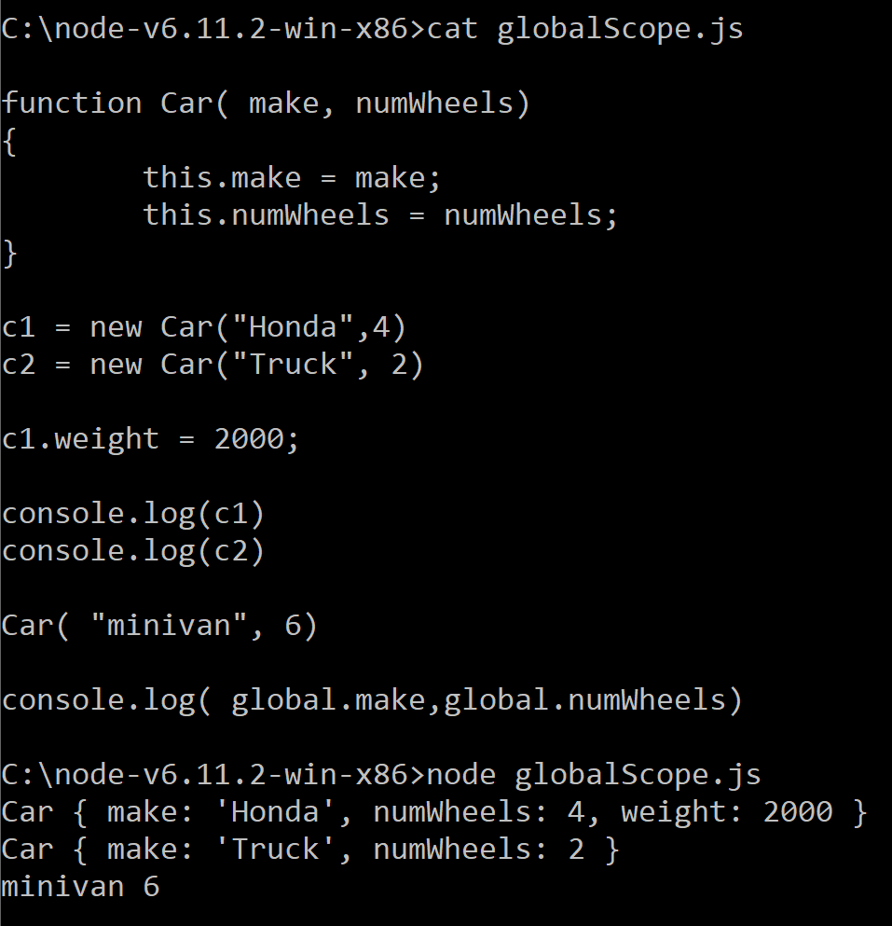
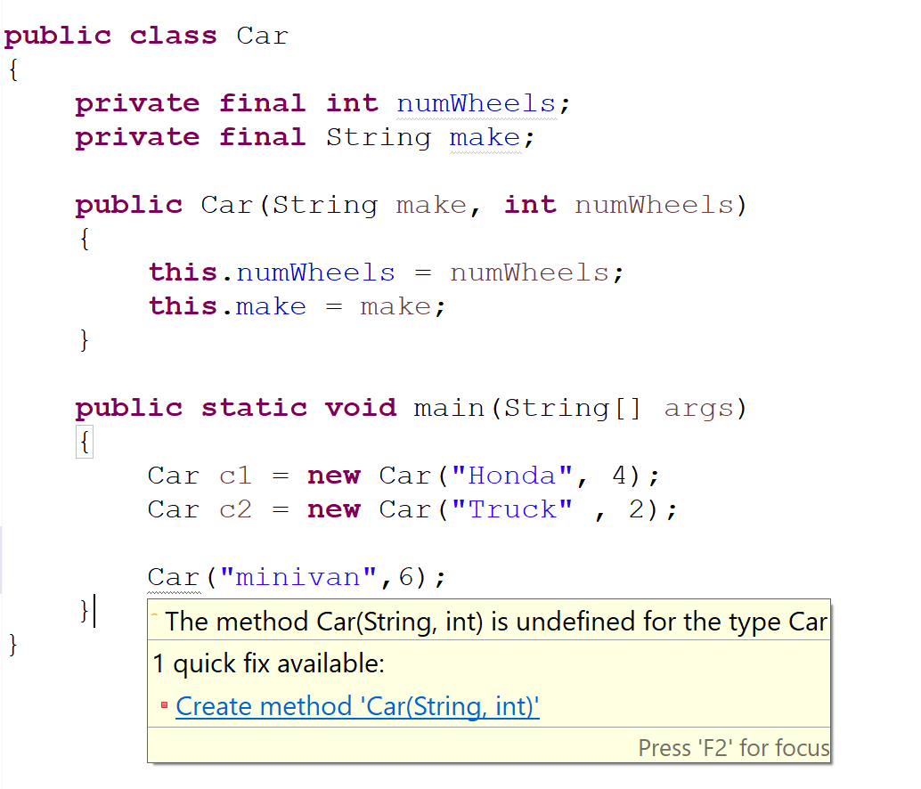
Java uses block-based scoping; JavaScript uses function-based scoping;
Since javascript constructors are just functions, they can be called without using new
There is no equivalent in Java;
There is no implicit “global” scope;
this is always attached to an instance of an object
The scope of “this” depends on the object on which
the function is invoked. The “global” object (in node.js)
Is invoked by default.

Slide 16
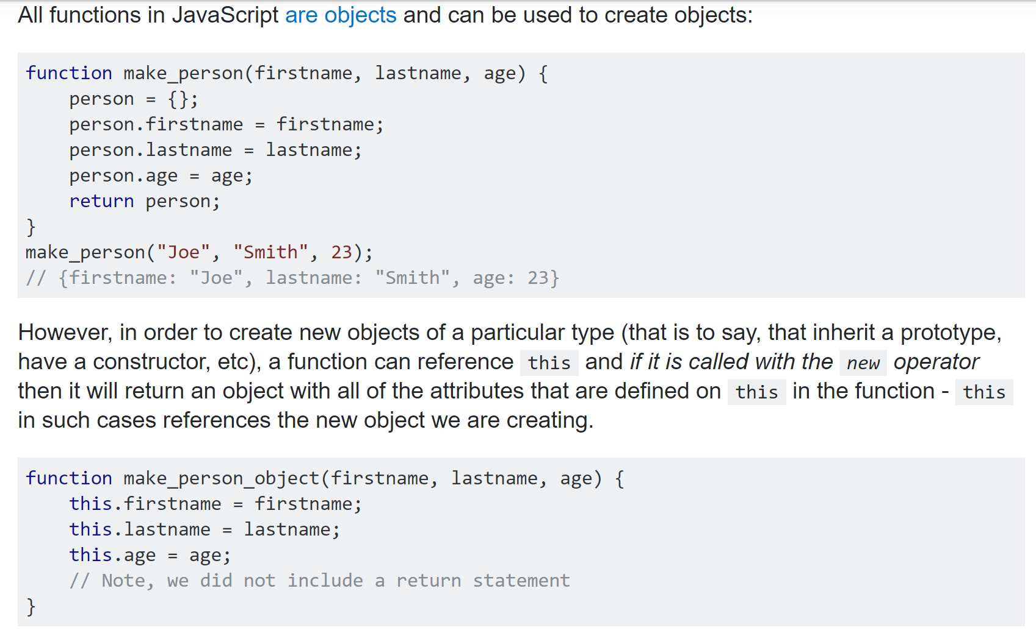
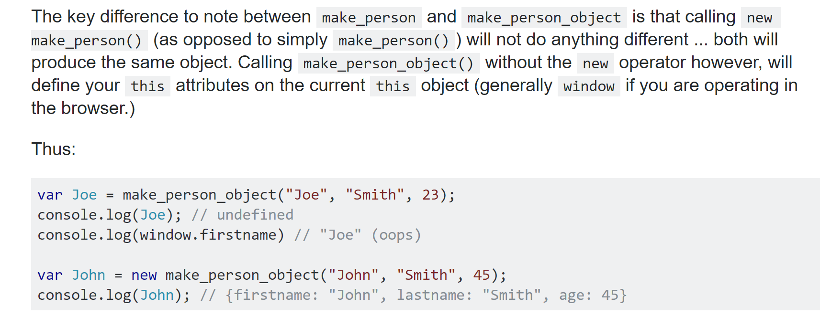
In javascript in the browser, the global scope has a different name (window)
https://stackoverflow.com/questions/5958417/javascript-function-and-object

Slide 17
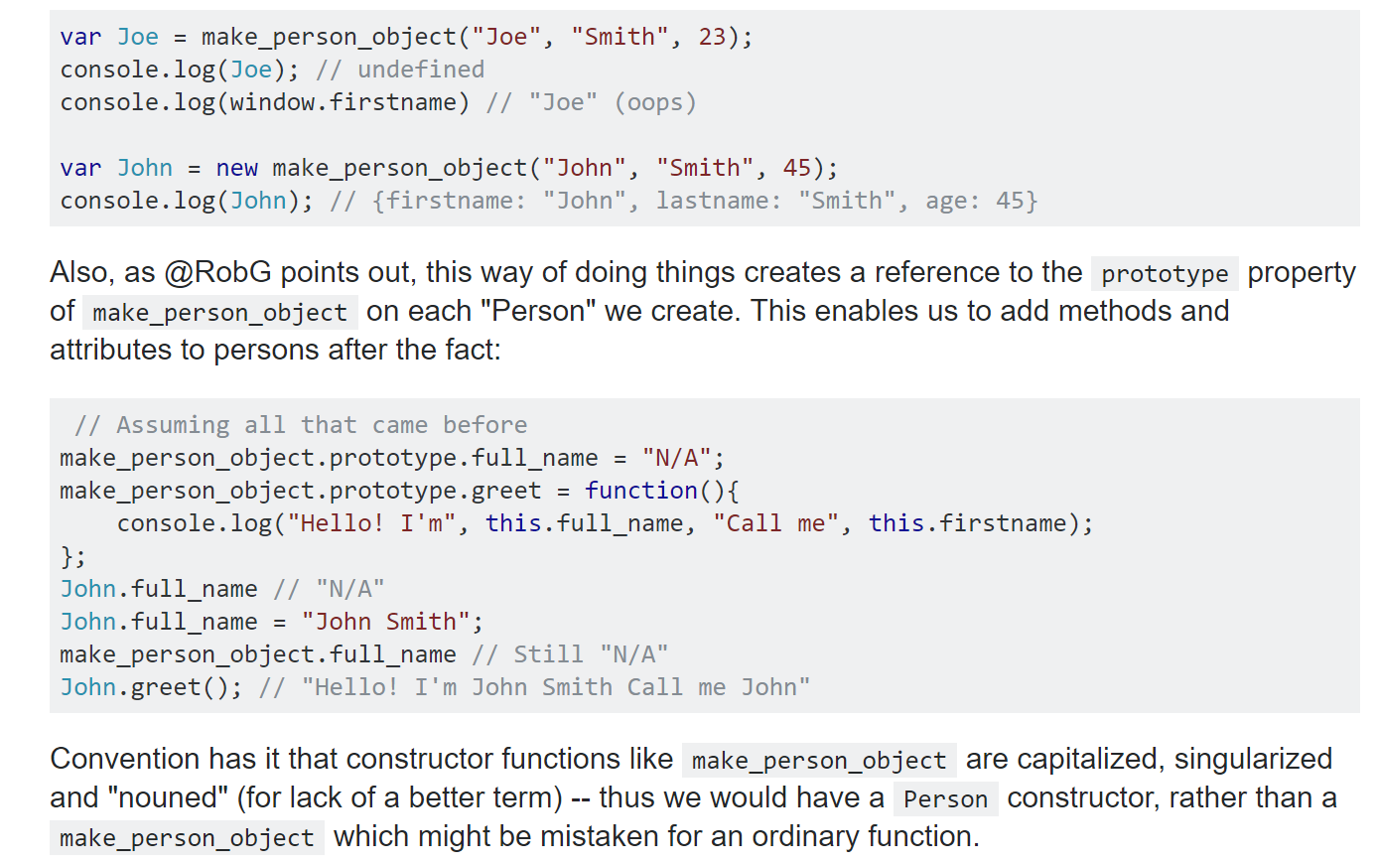
But the prototypes work the same way in the two enviornments and allow each object to have its own “instance” data….
https://stackoverflow.com/questions/5958417/javascript-function-and-object

Slide 18
Any object in javascript can serve as a prototype
https://developer.mozilla.org/en-US/docs/Web/JavaScript/Inheritance_and_the_prototype_chain

Slide 19
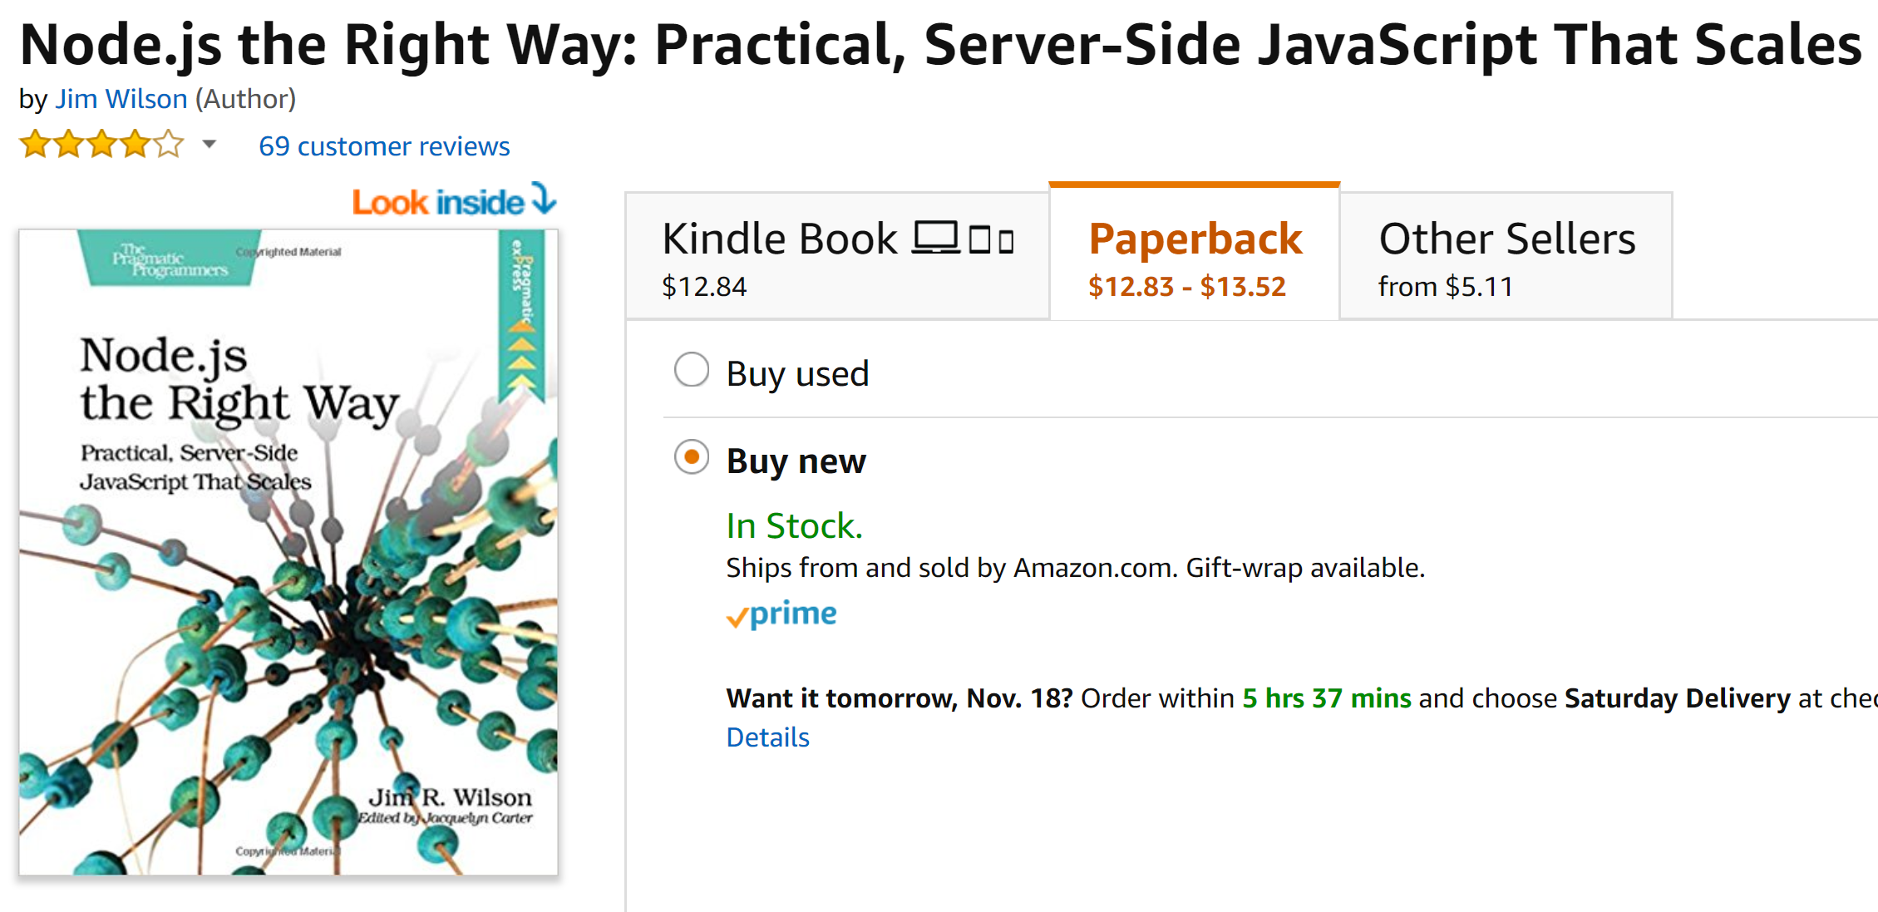

Slide 20
